Slide 1

Data-Intensive Distributed Computing
CS 451/651 431/631 (Winter 2018)
Part 5: Analyzing Relational Data (3/3)
February 15, 2018
Jimmy Lin
David R. Cheriton School of Computer Science
University of Waterloo
These slides are available at http://lintool.github.io/bigdata-2018w/
This work is licensed under a Creative Commons Attribution-Noncommercial-Share Alike 3.0 United States See http://creativecommons.org/licenses/by-nc-sa/3.0/us/ for details

Slide 2
MapReduce: A Major Step Backwards?
MapReduce is a step backward in database access
Schemas are good
Separation of the schema from the application is good
High-level access languages are good
MapReduce is poor implementation
Brute force and only brute force (no indexes, for example)
MapReduce is not novel
MapReduce is missing features
Bulk loader, indexing, updates, transactions…
MapReduce is incompatible with DBMS tools
Source: Blog post by DeWitt and Stonebraker

Slide 3
Hadoop vs. Databases: Grep
SELECT * FROM Data WHERE field LIKE ‘%XYZ%’;
Source: Pavlo et al. (2009) A Comparison of Approaches to Large-Scale Data Analysis. SIGMOD.

Slide 4
Hadoop vs. Databases: Select
SELECT pageURL, pageRank
FROM Rankings WHERE pageRank > X;
Source: Pavlo et al. (2009) A Comparison of Approaches to Large-Scale Data Analysis. SIGMOD.

Slide 5
Hadoop vs. Databases: Aggregation
SELECT sourceIP, SUM(adRevenue)
FROM UserVisits GROUP BY sourceIP;
Source: Pavlo et al. (2009) A Comparison of Approaches to Large-Scale Data Analysis. SIGMOD.

Slide 6
Hadoop vs. Databases: Join
SELECT INTO Temp sourceIP, AVG(pageRank) as avgPageRank, SUM(adRevenue) as totalRevenue
FROM Rankings AS R, UserVisits AS UV
WHERE R.pageURL = UV.destURL AND UV.visitDate BETWEEN Date('2000-01-15’) AND Date('2000-01-22’) GROUP BY UV.sourceIP;
SELECT sourceIP, totalRevenue, avgPageRank FROM Temp ORDER BY totalRevenue DESC LIMIT 1;
Source: Pavlo et al. (2009) A Comparison of Approaches to Large-Scale Data Analysis. SIGMOD.

Slide 7

Hadoop is slow...
Source: Wikipedia (Tortoise)

Slide 8

Something seems fishy…
Source: Wikipedia (Fish)

Slide 9
Why was Hadoop slow?
Integer.parseInt
String.substring
String.split
Hadoop slow because string manipulation is slow?

Slide 10
Key Ideas
Binary representations are good
Binary representations need schemas
Schemas allow logical/physical separation
Logical/physical separation allows you to do cool things

Slide 11
Thrift
Originally developed by Facebook, now an Apache project
Provides a DDL with numerous language bindings
Compact binary encoding of typed structs
Fields can be marked as optional or required
Compiler automatically generates code for manipulating messages
Provides RPC mechanisms for service definitions
Don’t like Thrift? Alternatives include protobufs and Avro

Slide 12
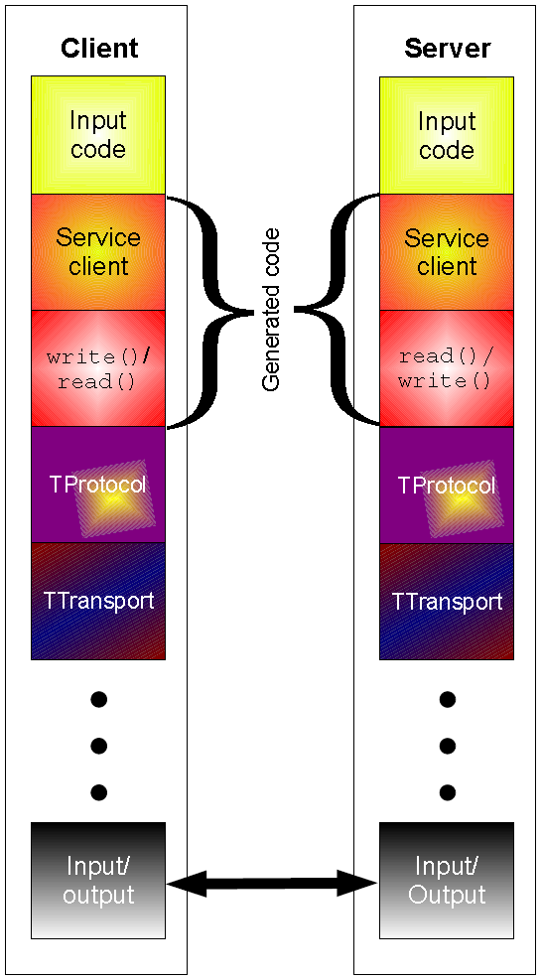
Thrift
struct Tweet {
1: required i32 userId;
2: required string userName;
3: required string text;
4: optional Location loc;
}
struct Location {
1: required double latitude;
2: required double longitude;
}

Slide 13
Why not…
XML or JSON?
REST?

Slide 14
Logical
R₁
R₂
R₃
Physical
How bytes are actually represented in storage…

Slide 15
Row vs. Column Stores
R₁
R₂
R₃
R₄
Row store
Column store

Slide 16
Row vs. Column Stores
Row stores
Easier to modify a record: in-place updates
Might read unnecessary data when processing
Column stores
Only read necessary data when processing
Tuple writes require multiple operations
Tuple updates are complex

Slide 17
external APIs
users
users
Frontend
Frontend
Frontend
Backend
Backend
Backend
OLTP database
OLTP database
OLTP database
ETL (Extract, Transform, and Load)
OLAP Data Warehouse
BI tools
analysts

Slide 18
Advantages of Column Stores
Inherent advantages:
Better compression
Read efficiency
Works well with:
Vectorized Execution
Compiled Queries
These are well-known in traditional databases…

Slide 19
Row vs. Column Stores: Compression
R₁
R₂
R₃
R₄
Row store
Column store
This compresses better with off-the-shelf tools, e.g., gzip.
Why?

Slide 20
Row vs. Column Stores: Compression
R₁
R₂
R₃
R₄
Row store
Column store
Additional opportunities for smarter compression…

Slide 21
Columns Stores: RLE
Column store
Run-length encoding example:
is a foreign key, relatively small cardinality
(even better, boolean)
In reality:
…
Encode:
3
2
1 …

Slide 22
Columns Stores: Integer Coding
Column store
Say you’re coding a bunch of integers…

Slide 23
Remember this?
VByte
(Part 3)
Simple idea: use only as many bytes as needed
Need to reserve one bit per byte as the “continuation bit”
Use remaining bits for encoding value
7 bits
0
14 bits
1
0
21 bits
1
1
0
Works okay, easy to implement…
Beware of branch mispredicts!

Slide 24
Remember this?
Simple-9
(Part 3)
How many different ways can we divide up 28 bits?
28 1-bit numbers
14 2-bit numbers
9 3-bit numbers
7 4-bit numbers
“selectors”
(9 total ways)
Efficient decompression with hard-coded decoders
Simple Family – general idea applies to 64-bit words, etc.
Beware of branch mispredicts?

Slide 25
Remember this?
Bit Packing
(Part 3)
What’s the smallest number of bits we need to code a block (=128) of integers?
3
…
4
…
5
…
Efficient decompression with hard-coded decoders
PForDelta – bit packing + separate storage of “overflow” bits
Beware of branch mispredicts?

Slide 26
Advantages of Column Stores
Inherent advantages:
Better compression
Read efficiency
Works well with:
Vectorized Execution
Compiled Queries

Slide 27
Putting Everything Together
SELECT big1.fx, big2.fy, small.fz
FROM big1
JOIN big2 ON big1.id1 = big2.id1
JOIN small ON big1.id2 = small.id2
WHERE big1.fx = 2015 AND big2.f1 < 40 AND big2.f2 > 2;
project
join
join
select
select
Build logical plan
project
project
Optimize logical plan
Select physical plan
big1
big2
small

Slide 28
val size = 100000000
var col = new Array[Int](size) // List of random ints
var selected = new Array[Boolean](size) // Matches a predicate?
for (i <- 0 until size) {
selected(i) = col(i) > 0
}
for (i <- 0 until size by 8) {
selected(i) = col(i) > 0
selected(i+1) = col(i+1) > 0
selected(i+2) = col(i+2) > 0
selected(i+3) = col(i+3) > 0
selected(i+4) = col(i+4) > 0
selected(i+5) = col(i+5) > 0
selected(i+6) = col(i+6) > 0
selected(i+7) = col(i+7) > 0
}
Which is faster?
Why?
On my laptop: 409ms
(avg over 10 trials)
On my laptop: 174ms
(avg over 10 trials)

Slide 29
val size = 100000000
var col = new Array[Int](size) // List of random ints
var selected = new Array[Boolean](size) // Matches a predicate?
for (i <- 0 until size) {
selected(i) = col(i) > 0
}
for (i <- 0 until size by 8) {
selected(i) = col(i) > 0
selected(i+1) = col(i+1) > 0
selected(i+2) = col(i+2) > 0
selected(i+3) = col(i+3) > 0
selected(i+4) = col(i+4) > 0
selected(i+5) = col(i+5) > 0
selected(i+6) = col(i+6) > 0
selected(i+7) = col(i+7) > 0
}
Why does it matter?
SELECT pageURL, pageRank
FROM Rankings WHERE pageRank > X;
On my laptop: 409ms
(avg over 10 trials)
On my laptop: 174ms
(avg over 10 trials)

Slide 30
Actually, it’s worse than that!
Each operator implements a common interface
open()
Initialize, reset internal state, etc.
next()
Advance and deliver next tuple
close()
Clean up, free resources, etc.
Execution driven by repeated calls to top of operator tree

Slide 31
open() next() next()... close()
pageURL, pageRank
open() next() next()... close()
pageRank > X
open() next() next()... close()
Read(Rankings)
SELECT pageURL, pageRank
FROM Rankings WHERE pageRank > X;
Very little actual computation is being done!

Slide 32
open() next() next()... close()
pageURL, pageRank
open() next() next()... close()
pageRank > X
open() next() next()... close()
Read(Rankings)
SELECT pageURL, pageRank
FROM Rankings WHERE pageRank > X;
Solution?

Slide 33
val size = 100000000
var col = new Array[Int](size) // List of random ints
var selected = new Array[Boolean](size) // Matches a predicate?
✗
✔
for (i <- 0 until size) {
selected(i) = col(i) > 0
}
for (i <- 0 until size by 8) {
selected(i) = col(i) > 0
selected(i+1) = col(i+1) > 0
selected(i+2) = col(i+2) > 0
selected(i+3) = col(i+3) > 0
selected(i+4) = col(i+4) > 0
selected(i+5) = col(i+5) > 0
selected(i+6) = col(i+6) > 0
selected(i+7) = col(i+7) > 0
}
Vectorized Execution
next() returns a vector of tuples
All operators rewritten to work on vectors of tuples
Can we do even better?

Slide 34
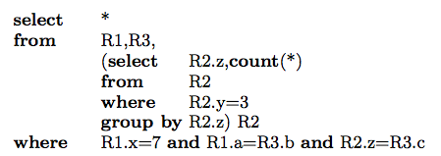
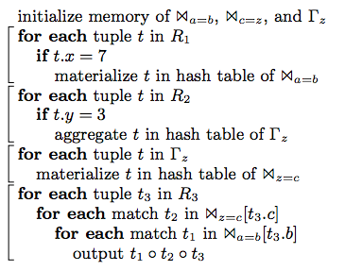
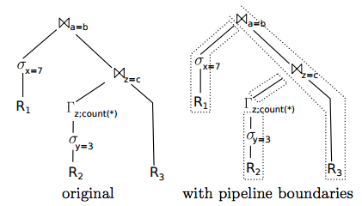
Compiled Queries
Source: Neumann (2011) Efficiently Compiling Efficient Query Plans for Modern Hardware. VLDB.

Slide 35
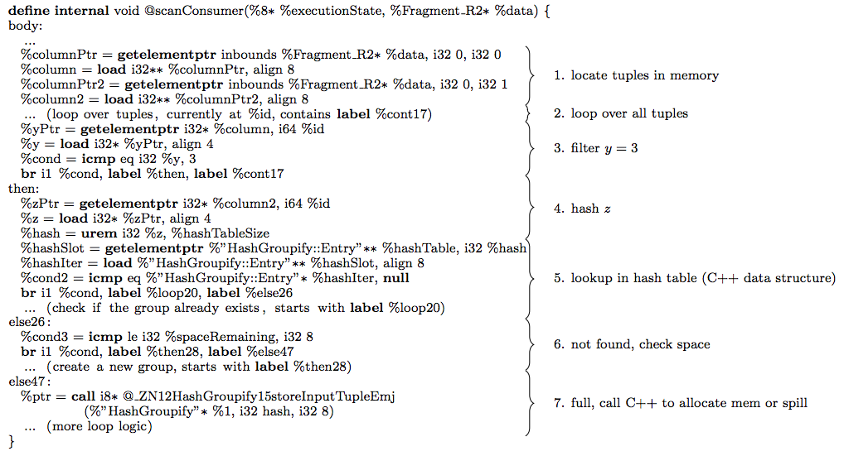
Compiled Queries
Example LLVM query template
Source: Neumann (2011) Efficiently Compiling Efficient Query Plans for Modern Hardware. VLDB.

Slide 36
Advantages of Column Stores
Inherent advantages:
Better compression
Read efficiency
Works well with:
Vectorized Execution
Compiled Queries
These are well-known in traditional databases…
Why not in Hadoop?

Slide 37
Why not in Hadoop?
No reason why not!
RCFile
Source: He et al. (2011) RCFile: A Fast and Space-Efficient Data Placement Structure in MapReduce-based Warehouse Systems. ICDE.

Slide 38

✔
Vectorized Execution?
set hive.vectorized.execution.enabled = true;
Batch of rows, organized as columns:
class VectorizedRowBatch {
boolean selectedInUse;
int[] selected;
int size;
ColumnVector[] columns;
}
class LongColumnVector extends ColumnVector {
long[] vector
}

Slide 39
✔
Vectorized Execution?
class LongColumnAddLongScalarExpression {
int inputColumn;
int outputColumn;
long scalar;
void evaluate(VectorizedRowBatch batch) {
long [] inVector = ((LongColumnVector)
batch.columns[inputColumn]).vector;
long [] outVector = ((LongColumnVector)
batch.columns[outputColumn]).vector;
if (batch.selectedInUse) {
for (int j = 0; j < batch.size; j++) {
int i = batch.selected[j];
outVector[i] = inVector[i] + scalar;
}
} else {
for (int i = 0; i < batch.size; i++) {
outVector[i] = inVector[i] + scalar;
}
}
}
}
Vectorized operator example

Slide 40

✔
Compiled Queries?
SELECT x, y
FROM z WHERE x * (1 – y)/100 < 434;
Predicate is “interpreted” as
LessThan(
Multiply(Attribute("x"),
Divide(Minus(Literal("1"), Attribute("y")), 100)),
434)
Slow!
Dynamic code generation (feed AST into Scala compiler to generate bytecode):
row.get("x") * (1 – row.get("y"))/100 < 434
Much faster!

Slide 41
Advantages of Column Stores
Inherent advantages:
Better compression
Read efficiency
Works well with:
Vectorized Execution
Compiled Queries
Hadoop can adopt all of these optimizations!

Slide 42
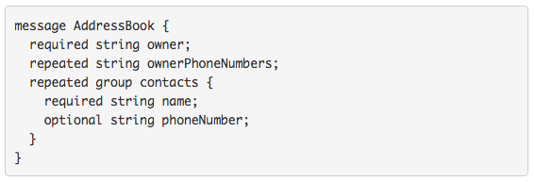
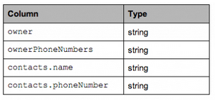
What about semi-structured data?
Required: exactly one occurrence
Optional: 0 or 1 occurrence
Repeated: 0 or more occurrences
Columnar Decomposition
What’s the issue?

Slide 43

What’s the solution?
Google’s Dremel storage model
Open-source implementation in Parquet
Source: https://blog.twitter.com/2013/dremel-made-simple-with-parquet

Slide 44
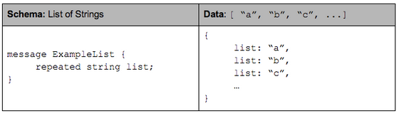
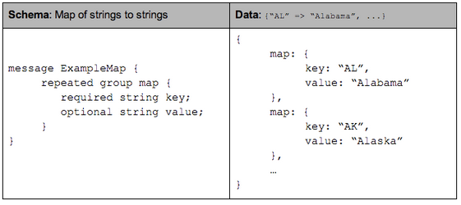
Optional and Repeated Elements

Slide 45
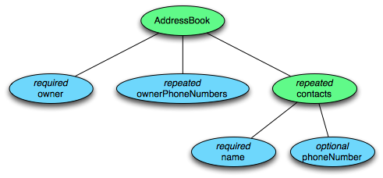
Tree Decomposition
Columnar Decomposition
What other information do we need to store?

Slide 46
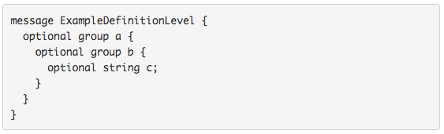
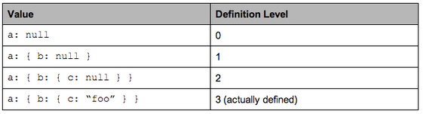
Definition Level

Slide 47
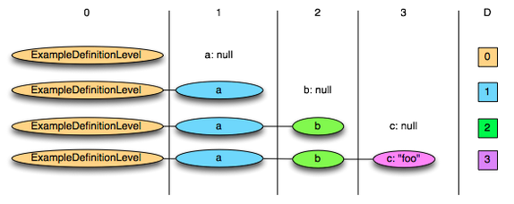
Definition Level: Illustration

Slide 48
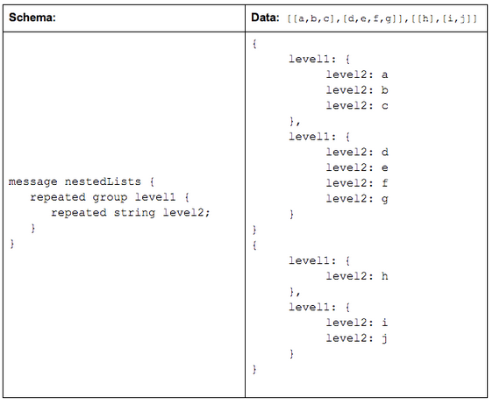
Repetition Level

Slide 49
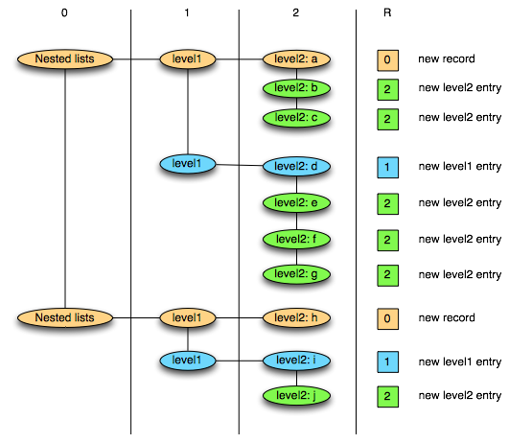
Repetition Level: Illustration
0 marks new record and implies creating a new level1 and level2 list
1 marks new level1 list and implies creating a new level2 list as well.
2 marks every new element in a level2 list.

Slide 50
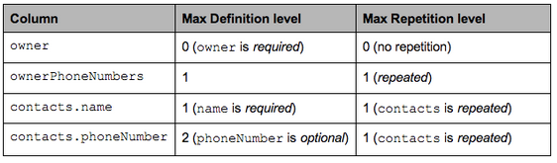
Putting It Together
Columnar Decomposition

Slide 51
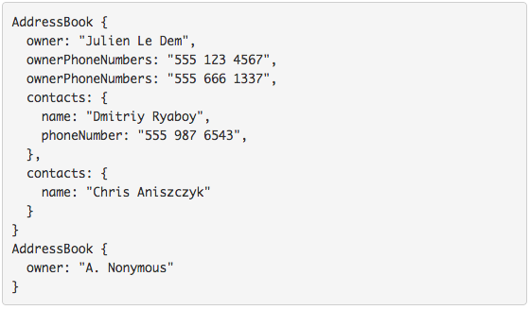
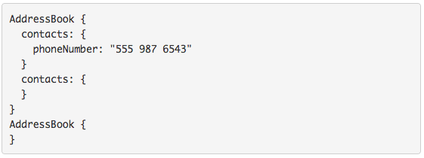
Sample Projection
Project onto contacts.phoneNumber

Slide 52
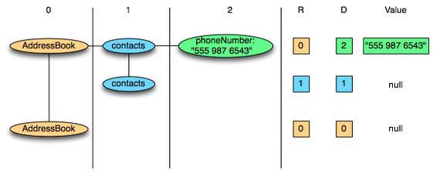
Physical Layout
Columnar Decomposition
Efficient Representations?

Slide 53
Key Ideas
Binary representations are good
Binary representations need schemas
Schemas allow logical/physical separation
Logical/physical separation allows you to do cool things

Slide 54
MapReduce: A Major Step Backwards?
MapReduce is a step backward in database access
Schemas are good
Separation of the schema from the application is good
High-level access languages are good
MapReduce is poor implementation
Brute force and only brute force (no indexes, for example)
MapReduce is not novel
MapReduce is missing features
Bulk loader, indexing, updates, transactions…
MapReduce is incompatible with DMBS tools
Source: Blog post by DeWitt and Stonebraker

Slide 55
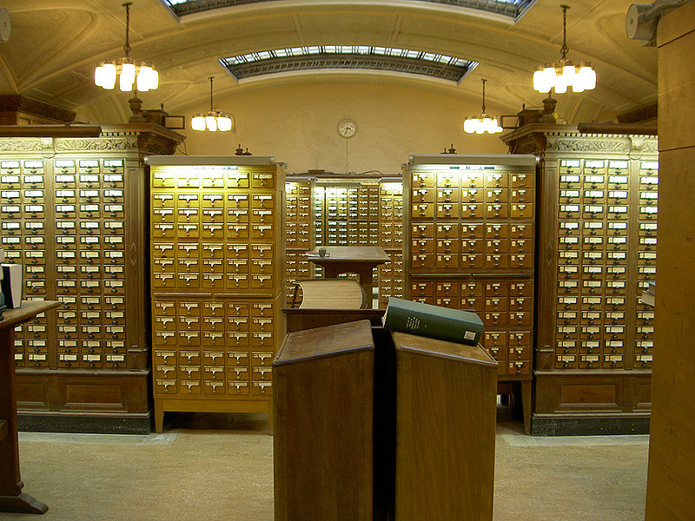
Indexes are a good thing!
Source: Wikipedia (Card Catalog)

Slide 56
Hadoop + Full-Text Indexes
status = load ’/tables/statuses/2011/03/01’
using StatusProtobufPigLoader()
as (id: long, user_id: long, text: chararray, ...);
filtered = filter status by text matches ’.*\\bhadoop\\b.*’;
…
Pig performs a brute force scan
Stupid.
Then promptly chucks out most of the data
Source: Lin et al. (2011) Full-Text Indexing for Optimizing Selection Operations in Large-Scale Data Analytics. MAPREDUCE Workshop.

Slide 57
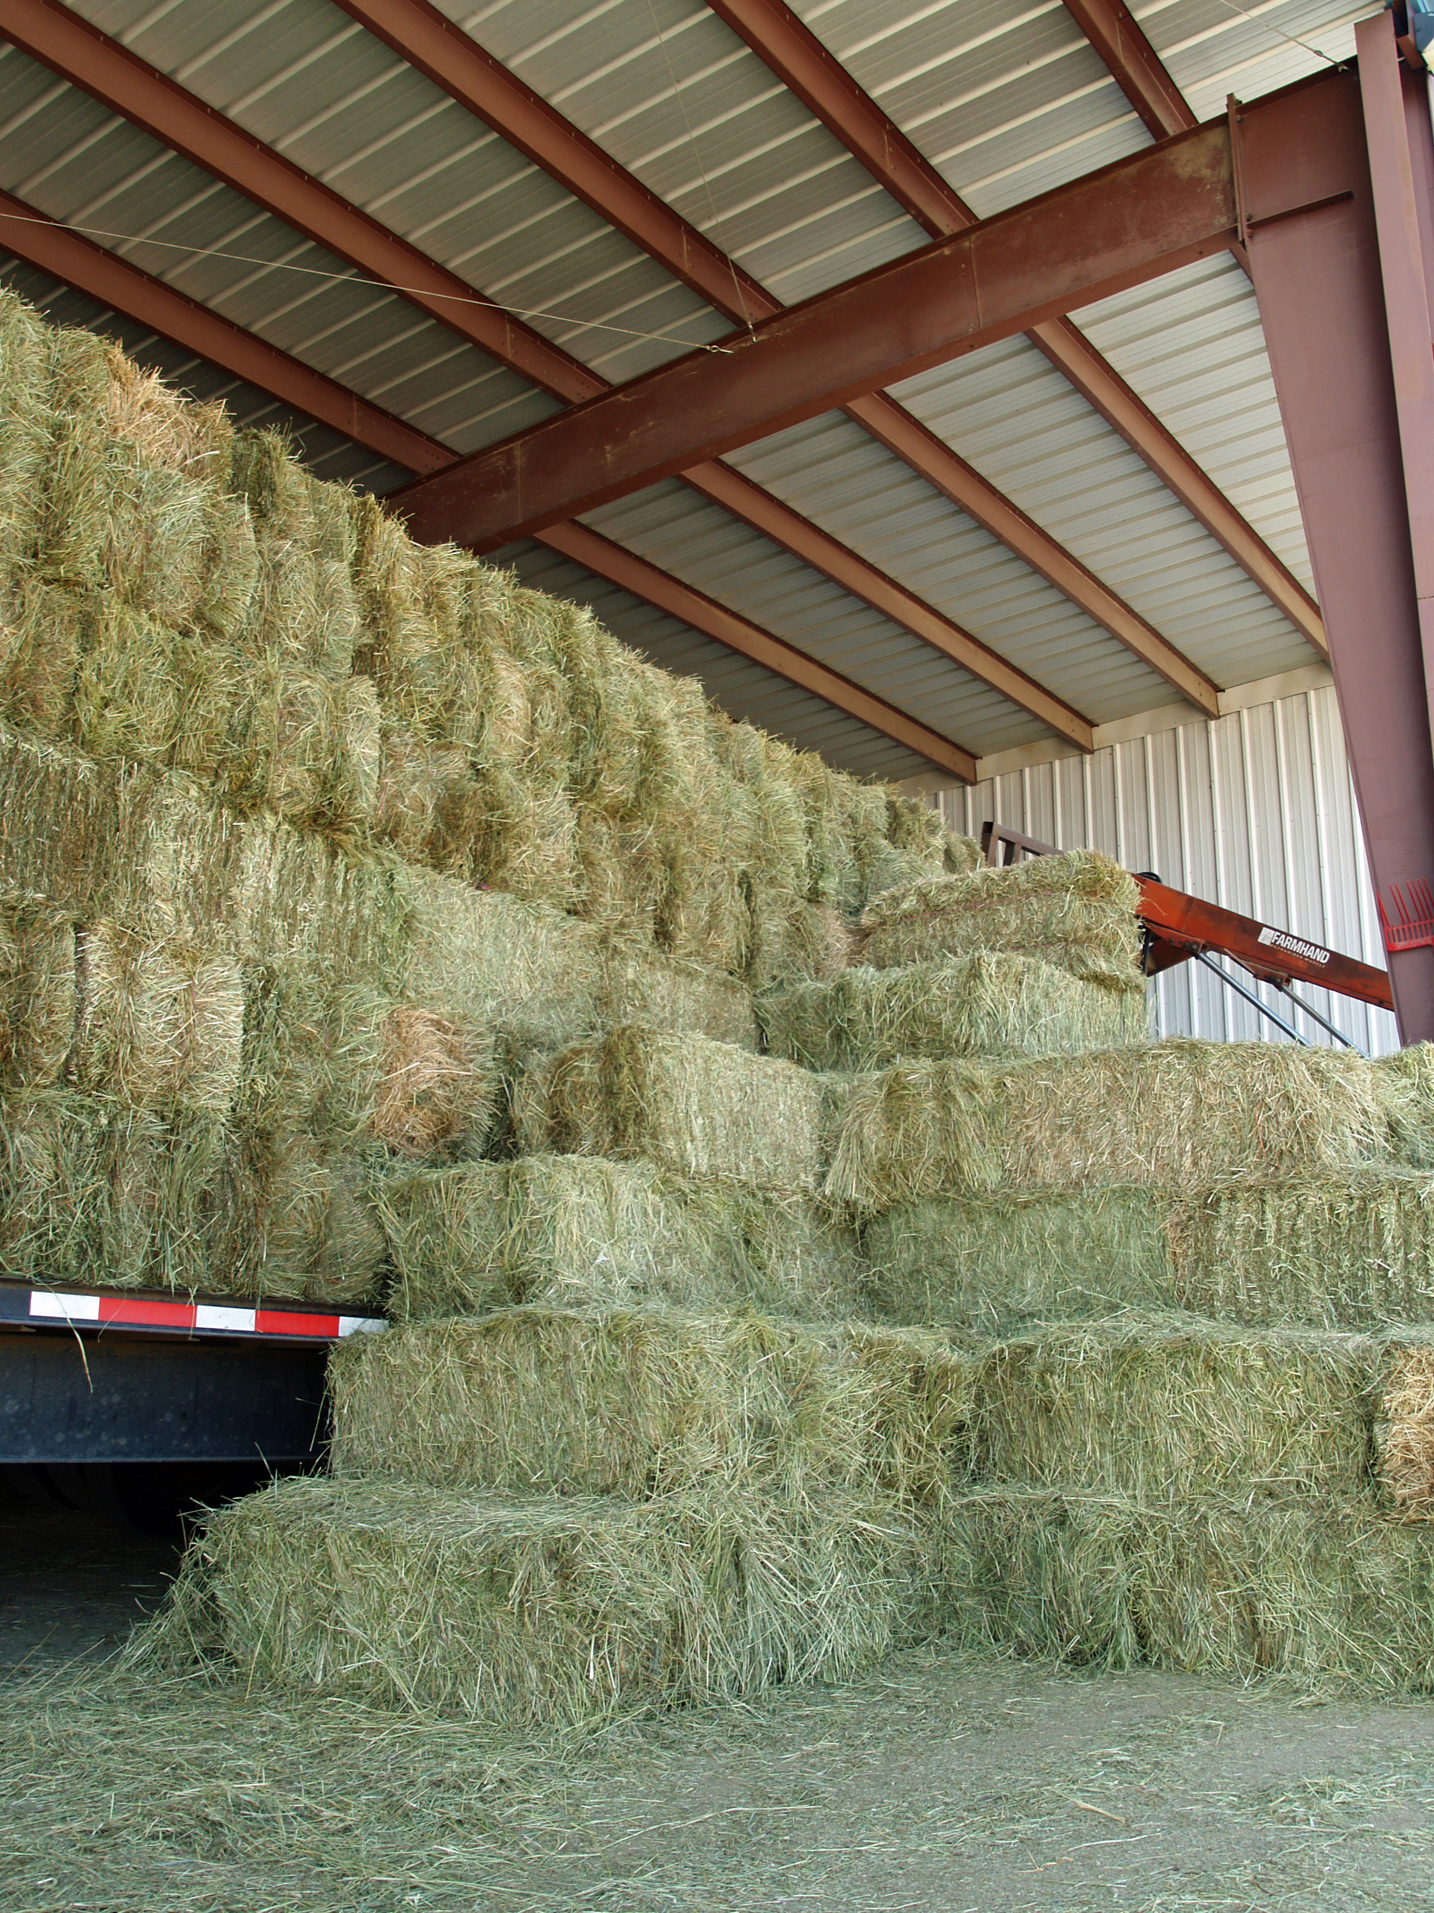
“Trying to find a needle in a haystack… with a snowplow”
@squarecog

Slide 58
Hadoop + Full-Text Indexes
status = load ’/tables/statuses/2011/03/01’
using StatusProtobufPigLoader()
as (id: long, user_id: long, text: chararray, ...);
filtered = filter status by text matches ’.*\\bhadoop\\b.*’;
…
Pig performs a brute force scan
Stupid.
Then promptly chucks out most of the data
Uhhh… how about an index?
Use Lucene full-text index

Slide 59
Client
LZO blocks
…
…
InputSplit
InputSplit
InputSplit
Mapper
Mapper
Mapper

Slide 60
Index-time
Lucene
Index
…
…
LZO blocks
…
…
Index for selection on tweet content
Build “pseudo-document” for each Lzo block
Index pseudo-documents with Lucene

Slide 61
Run-time
Lucene
Index
Client
LZO blocks
…
…
InputSplit
InputSplit
InputSplit
Mapper
Mapper
Mapper
Only process blocks known to satisfy selection criteria

Slide 62
Hadoop Integration
Everything encapsulated in the InputFormat
RecordReaders know what blocks to process and skip
Completely transparent to mappers

Slide 63
Experiments
Selection on tweet content
Varied selectivity range
One day sample data (70m tweets, 8/1/2010)

Slide 64
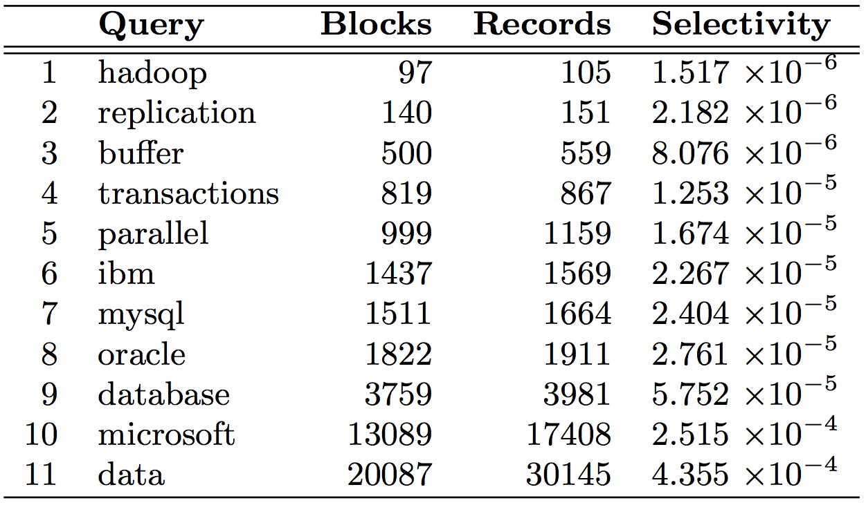

Slide 65
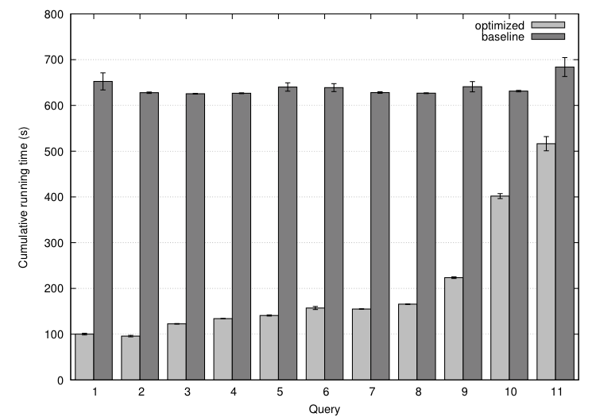

Slide 66
Analytical model
Task: prediction LZO blocks scanned by selectivity
Poisson model: P(observing k occurrences in a block)
E(fraction of blocks scanned)

Slide 67
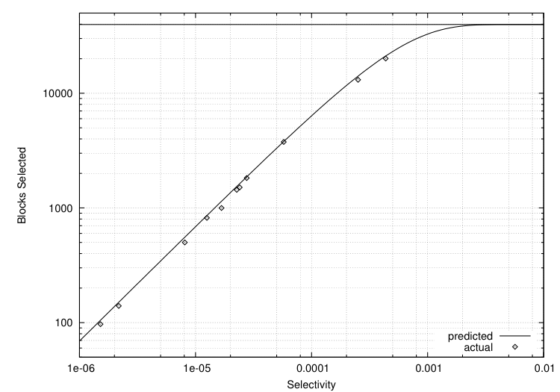
Selectivity 0.001 → 82% of all blocks
Selectivity 0.002 → 97% of all blocks
Total: ~40k blocks
But: can predict a priori!

Slide 68
MapReduce: A Major Step Backwards?
MapReduce is a step backward in database access
Schemas are good
Separation of the schema from the application is good
High-level access languages are good
MapReduce is poor implementation
Brute force and only brute force (no indexes, for example)
MapReduce is not novel
MapReduce is missing features
Bulk loader, indexing, updates, transactions…
MapReduce is incompatible with DMBS tools
Source: Blog post by DeWitt and Stonebraker

Slide 69

What’s Next?
Two developing trends…

Slide 70
users
Frontend
Backend
database
BI tools
analysts

Slide 71
external APIs
users
users
Frontend
Frontend
Frontend
Backend
Backend
Backend
OLTP database
OLTP database
OLTP database
ETL (Extract, Transform, and Load)
Data Warehouse
BI tools
analysts

Slide 72
external APIs
users
users
Frontend
Frontend
Frontend
Backend
Backend
Backend
OLTP database
OLTP database
OLTP database
ETL (Extract, Transform, and Load)
“Data Lake”
Data Warehouse
Other tools
SQL on Hadoop
“Traditional”
BI tools
My data is a
day old…
I refuse to accept that!
data scientists

Slide 73
ETL
OLTP
OLAP
What if you didn’t have to do this?

Slide 74
HTAP
Hybrid Transactional/Analytical Processing (HTAP)
Coming back full circle?

Slide 75
external APIs
users
users
Frontend
Frontend
Frontend
Backend
Backend
Backend
OLTP database
OLTP database
OLTP database
ETL (Extract, Transform, and Load)
“Data Lake”
Data Warehouse
Other tools
SQL on Hadoop
“Traditional”
BI tools
data scientists

Slide 76

external APIs
users
users
Frontend
Frontend
Frontend
Backend
Backend
Backend
HTAP database
HTAP database
HTAP database
Analytics
tools
Analytics
tools
data scientists
data scientists
ETL (Extract, Transform, and Load)
“Data Lake”
Data Warehouse
Other tools
SQL on Hadoop
“Traditional”
BI tools
data scientists

Slide 77
external APIs
users
users
Frontend
Frontend
Frontend
IaaS / Load balance aaS
Backend
Backend
Backend
DBaaS (e.g., RDS)
OLTP database
OLTP database
OLTP database
Everything
In the cloud!
ELT aaS
ETL (Extract, Transform, and Load)
DBaaS (e.g., RedShift)
“Data Lake”
Data Warehouse
S3
Other tools
SQL on Hadoop
“Traditional”
BI tools
“Cloudified” tools
data scientists

Slide 78
The datacenter is the computer!
“Big ideas”
*
Scale “out”, not “up”
Limits of SMP and large shared-memory machines
Assume that components will break
Engineer software around hardware failures
*
Move processing to the data
Cluster have limited bandwidth, code is a lot smaller
Process data sequentially, avoid random access
Seeks are expensive, disk throughput is good

Slide 79

Questions?
Source: Wikipedia (Japanese rock garden)

